Slide 1
Real-time Modeling and Software Framework for Estimating Greenhouse Gas Emissions
Vineet Yadav
Jet Propulsion Laboratory,
California Institute of Technology
11/11/2015

Slide 2
Objectives
A software design framework for real-time measurement and monitoring of greenhouse gas emissions
  Carbon dioxide (CO₂), Methane, Nitrous Oxide, Chlorofluorocarbons etc.
  Responsible for global climate change.
  Primary focus in this presentation is on CO₂
Provide insight into challenges associated with fulfilling the primary goal of OCO2 satellite
    Estimate fluxes of CO₂
Computational challenges associated with modeling to get estimates of greenhouse gas emissions
Notes:
In this presentation I would use CO2 as an example greenhouse gas for presenting my work.

Slide 3
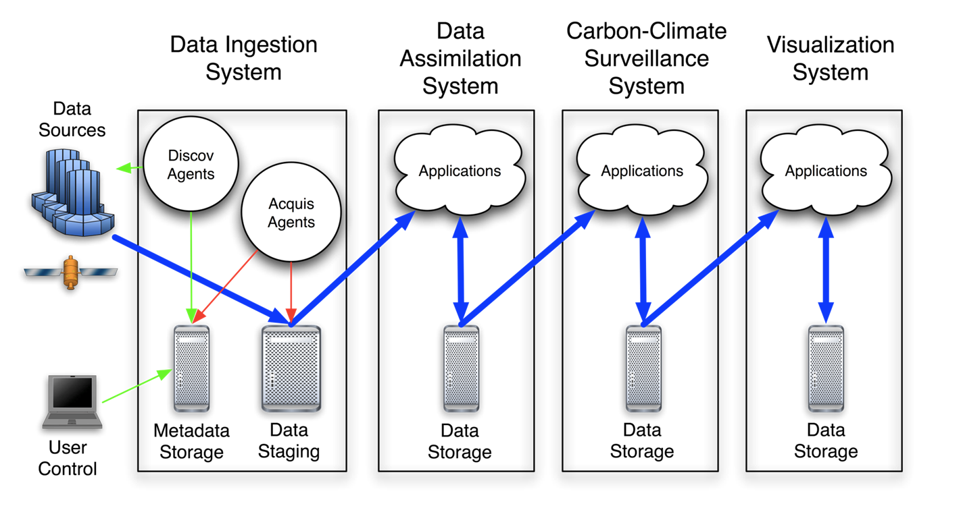
A software pipeline
Obs (XCO₂)
Models
Unusual
Patterns
Maps
Inverse Models
Notes:
Obs – Models – Analysis – Visualization. I would delve deep into one aspect of this software pipeline which comprises of models

Slide 4
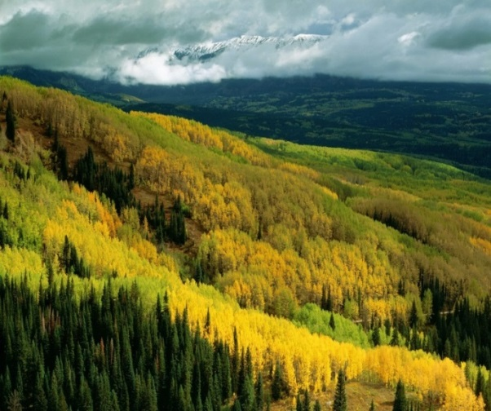
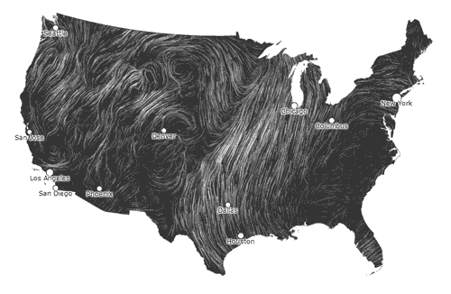
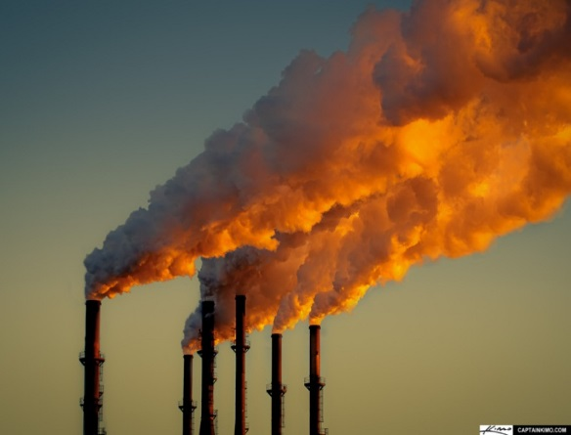
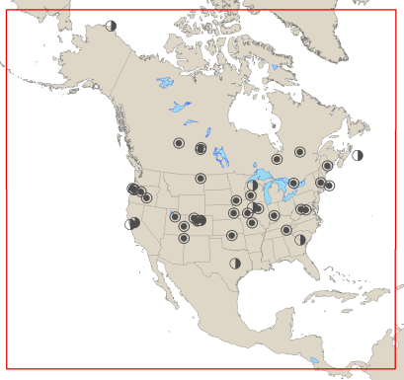
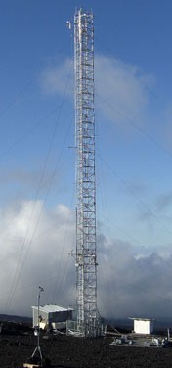
Measurements: Fluxes to Concentration (e.g. CO2)
Molecules of CO2
in Million Molecules
of Air (PPM)
Natural CO₂ Fluxes
Transport& Mixing
Atmospheric Measurements
CO₂ FF Emission
99.1 million metric tons of
CO2 (FF) released in
atmosphere in 2010 from LA county
Notes:
Change in carbon per unit time and per unit area. For e.g. kg m2 month goes to atmosphere. In 2010 LA county generated
99.1 million metric tons of CO2 equivalent greenhouse gas emission. 21.7 % california green house gas emissions

Slide 5
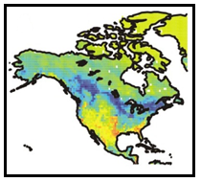
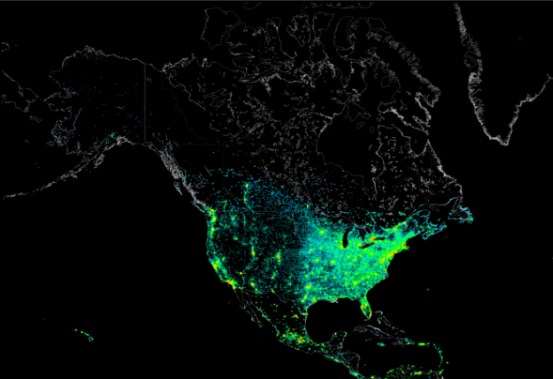
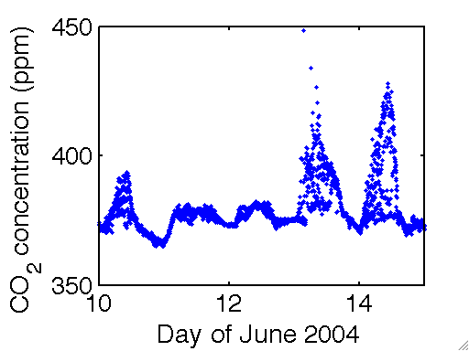
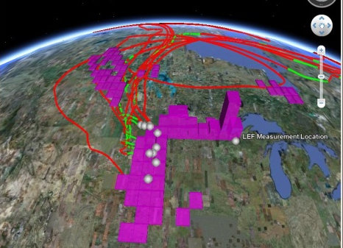
Inversions: Concentrations to Fluxes
Mean Natural and FF fluxes
Natural
Fossil Fuel
CO₂ Concentrations
Prior
Inversions
CO2 Emissions
Transport Model
Prior Covariance
ε_{Q}
Measurement
Covariance
ε_{R}
Moves Air with CO2
Molecules
Notes:
Moving forward. Generally the way batch inversion are done are
We have transport model from which we get a forward operator basically sensitivities to fluxes, a prior or auxiliary variables, CO2 observations that are measurements and a covariance which represents covariance of the residuals or to abuse it just the spatial pattern of the fluxes that needs to be estimated. You can imagine that in case if we just want to estimate biospheric fluxes then this is just the covariance of the spatial pattern of biospheric fluxes.

Slide 6
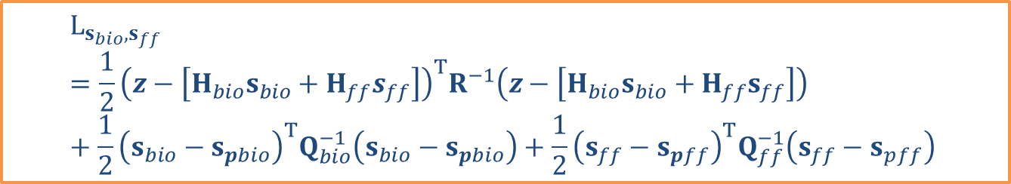


Inverse Modeling Equation
Measurement
Covariance
ε_{R}
CO₂ Observations
$$L_{s}= \frac{1}{2}{\left(z−Hs\right)}^{T}R^{−1}\left(z−Hs\right)+\frac{1}{2}{\left(s−s_{p}\right)}^{T}Q^{−1}\left(s−s_{p}\right)$$
Transport Model
Prior Covariance
ε_{Q}
CO2 Emissions
Disaggregated Version
$$L_{s_{bio},s_{ff}}=\frac{1}{2}{\left(z−\left[H_{bio}s_{bio}+H_{ff}s_{ff}\right]\right)}^{T}R^{−1}\left(z−\left[H_{bio}s_{bio}+H_{ff}s_{ff}\right]\right)+\frac{1}{2}{\left(s_{bio}−s_{pbio}\right)}^{T}Q_{bio}^{−1}\left(s_{bio}−s_{pbio}\right)+\frac{1}{2}{\left(s_{ff}−s_{pff}\right)}^{T}Q_{ff}^{−1}\left(s_{ff}−s_{pff}\right)$$

Slide 7
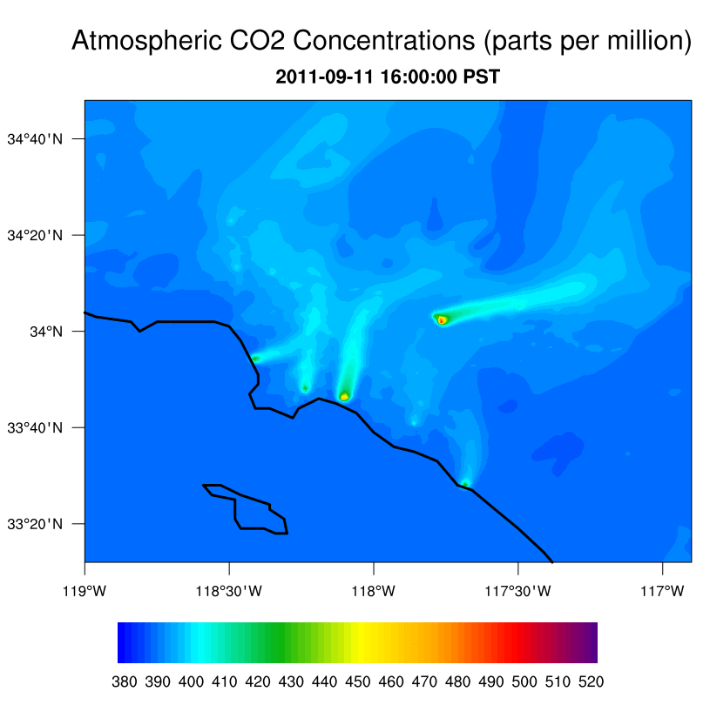
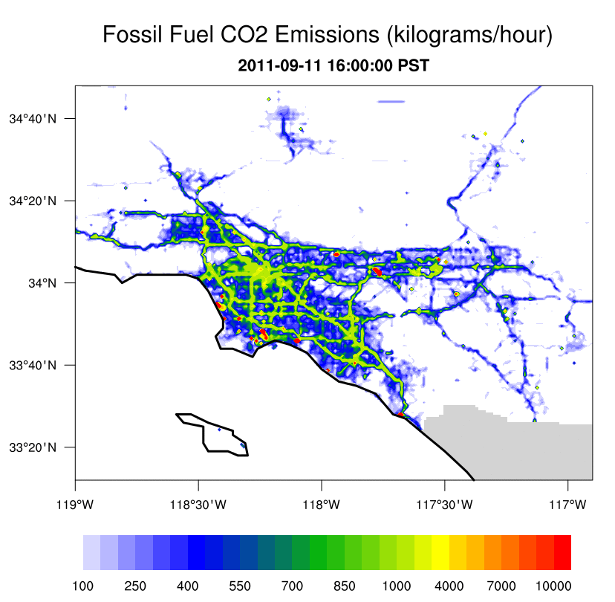


Measurements in Carbon Cycle Science: Fluxes to Concentration
Credits: Sha Feng (Penn State)

Slide 8
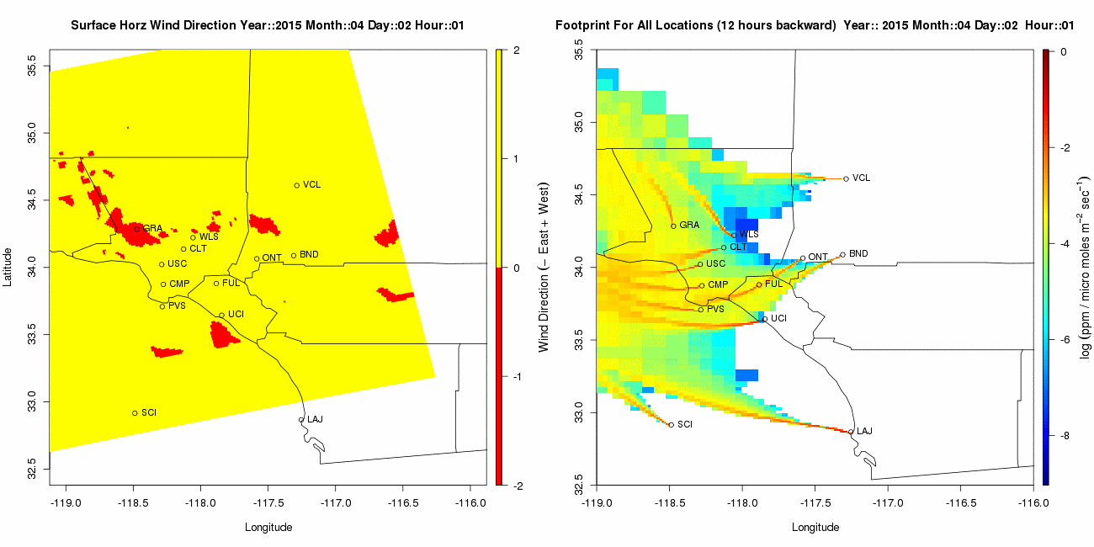

Complexity of Transport: Example of Los Angeles

Slide 9
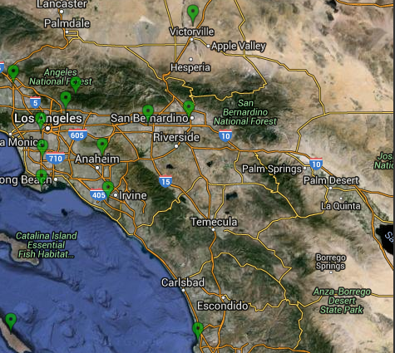
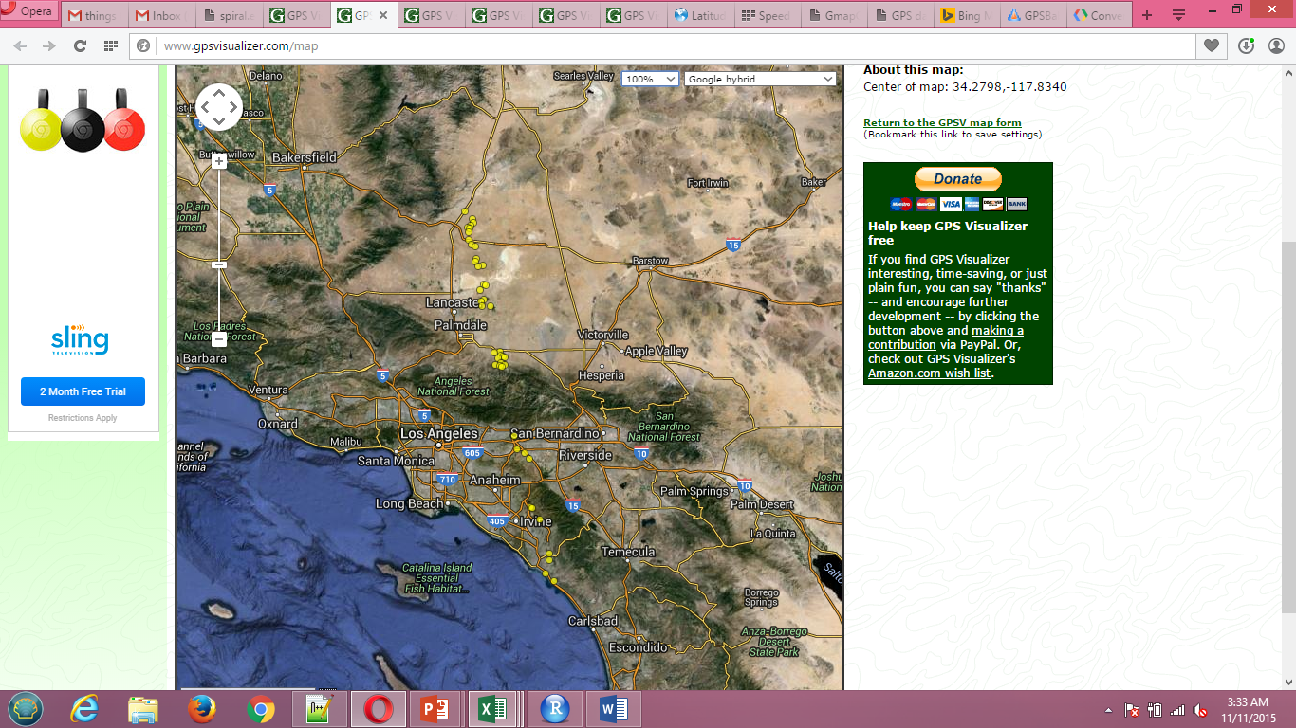
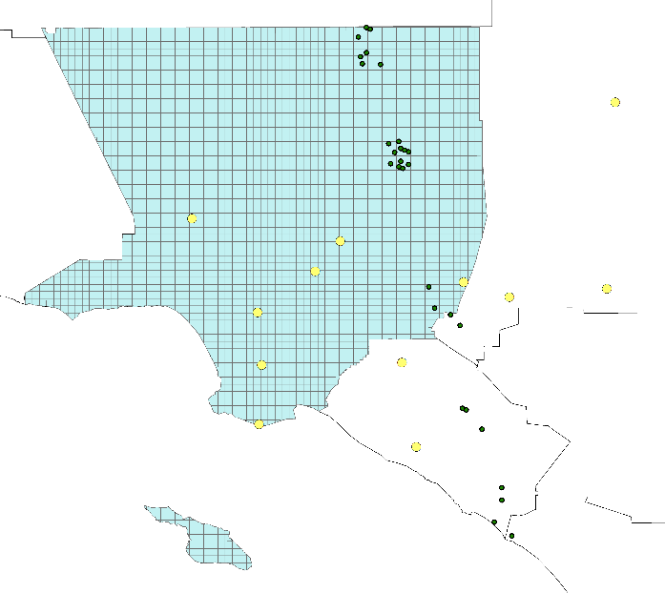
Sparsity of Measurements: Example of Los Angeles
Observations From in-situ Network
OCO2 Observations April 1 2015
Underdetermined problem
Illposed-problem

Slide 10
Computational Hurdles in Inverse Modeling
Matrix Multiplication
Computation of Uncertainties
Solution of Linear Systems of Equations
Optimization of covariance parameters

Slide 11
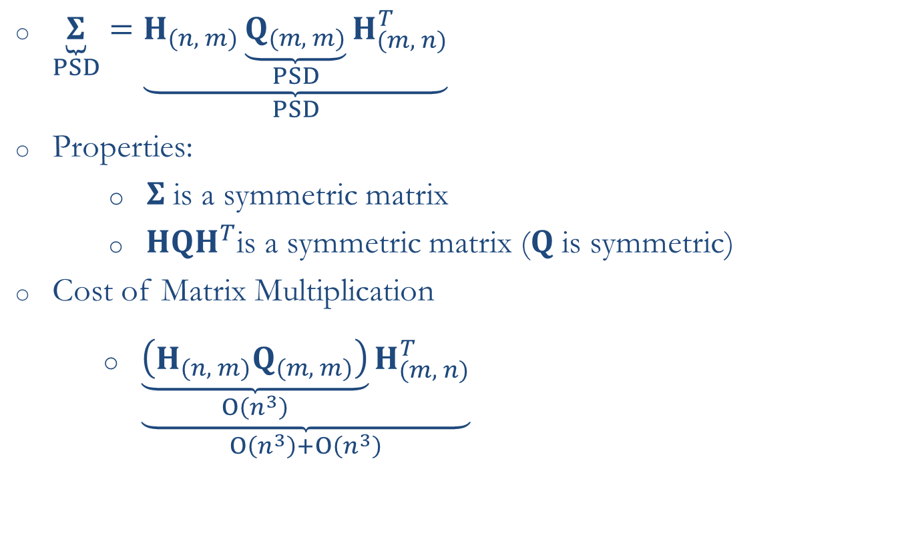
The Matrix Multiplication Problem
$$L_{s}= \frac{1}{2}{\left(z−Hs\right)}^{T}R^{−1}\left(z−Hs\right)+\frac{1}{2}{\left(s−s_{p}\right)}^{T}Q^{−1}\left(s−s_{p}\right)$$
$\underset{PSD}{\underbrace{Σ}}=\underset{PSD}{\underbrace{H_{(n, m)}\underset{PSD}{\underbrace{Q_{(m, m)}}}H_{(m, n)}^{T}}}$
Properties:
        $Σ$ is a symmetric matrix
                ${HQH}^{T}$is a symmetric matrix ($Q$ is symmetric)
Cost of Matrix Multiplication
        $\underset{O\left(n^{3}\right)+O\left(n^{3}\right)}{\underbrace{\underset{O\left(n^{3}\right)}{\underbrace{\left(H_{(n, m)}Q_{(m, m)}\right)}}H_{(m, n)}^{T}}}$

Slide 12
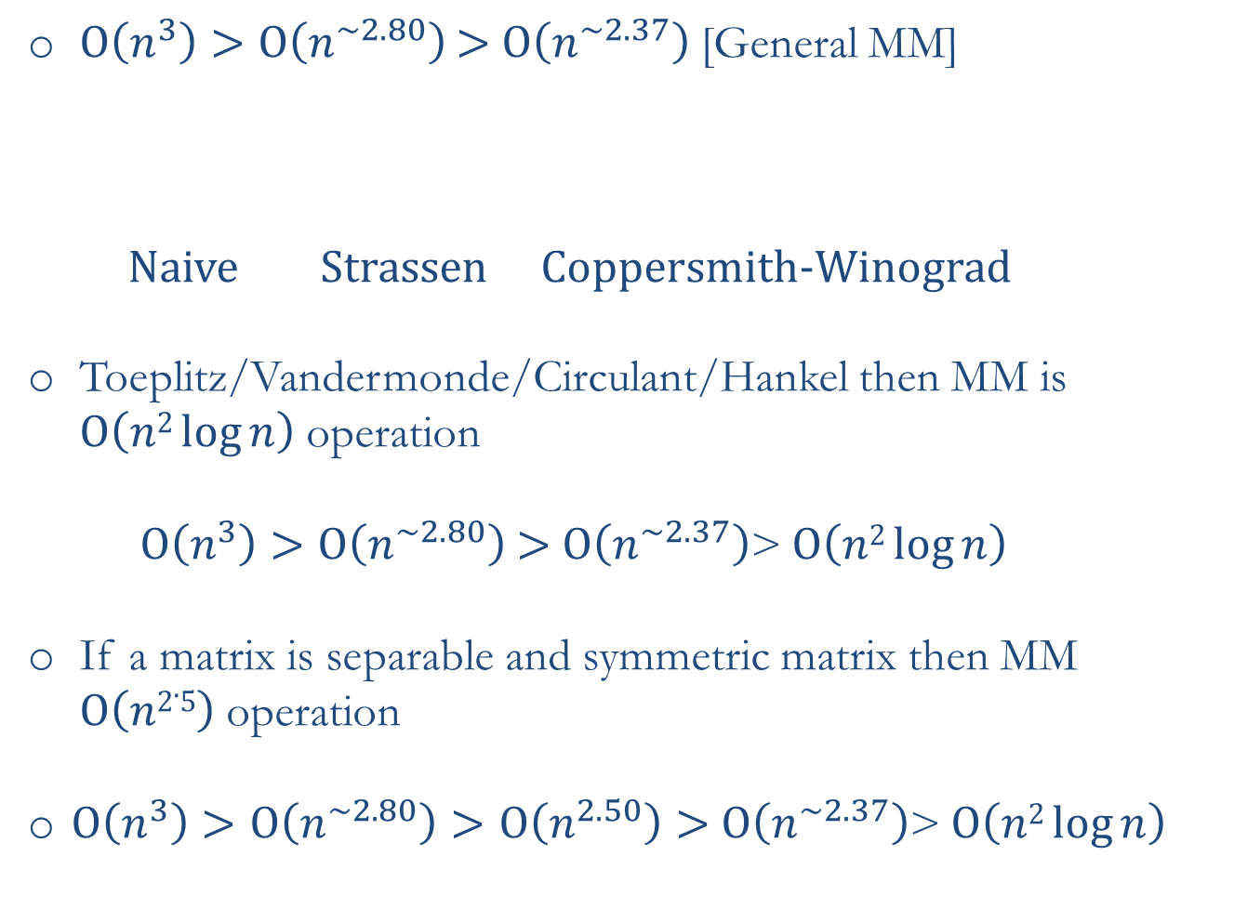
Algorithms for Matrix Multiplication (MM)
$O\left(n^{3}\right)>O\left(n^{\sim 2.80}\right)$ $>$ $O\left(n^{\sim 2.37}\right)$ [General MM]
  Naive Strassen Coppersmith-Winograd
Toeplitz/Vandermonde/Circulant/Hankel then MM is $O\left(n2\log{n}\right)$ operation
$O\left(n^{3}\right)>O\left(n^{\sim 2.80}\right)$ $>$ $O\left(n^{\sim 2.37}\right)$>$O\left(n2\log{n}\right)$
If a matrix is separable and symmetric matrix then MM $O\left(n2.5\right)$ operation
$O\left(n^{3}\right)>O\left(n^{\sim 2.80}\right)>O\left(n^{2.50}\right)>$ $O\left(n^{\sim 2.37}\right)$>$O\left(n2\log{n}\right)$

Slide 13
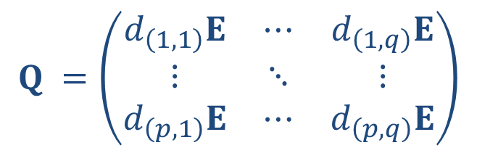
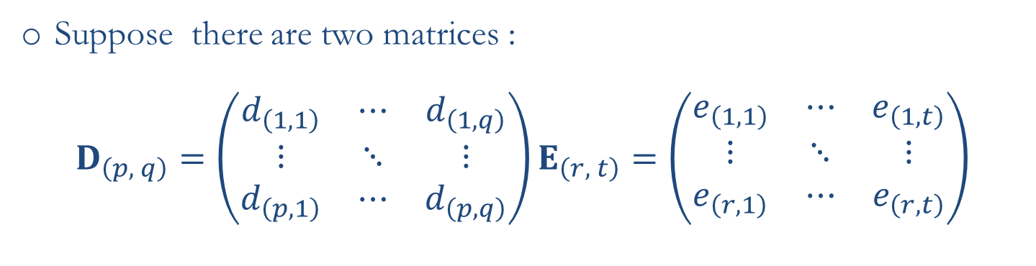
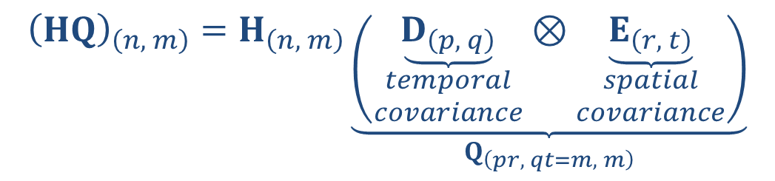

Decomposition of the prior covariance matrix
Suppose there are two matrices :
$$D_{\left(p, q\right)}=\left(\begin{matrix}d_{\left(1,1\right)} & ⋯ & d_{\left(1,q\right)} \\ ⋮ & ⋱ & ⋮ \\ d_{\left(p,1\right)} & ⋯ & d_{\left(p,q\right)}\end{matrix}\right)E_{\left(r, t\right)}=\left(\begin{matrix}e_{\left(1,1\right)} & ⋯ & e_{\left(1,t\right)} \\ ⋮ & ⋱ & ⋮ \\ e_{\left(r,1\right)} & ⋯ & e_{\left(r,t\right)}\end{matrix}\right)$$
$$Q =\left(\begin{matrix}d_{\left(1,1\right)}E & ⋯ & d_{\left(1,q\right)}E \\ ⋮ & ⋱ & ⋮ \\ d_{\left(p,1\right)}E & ⋯ & d_{\left(p,q\right)}E\end{matrix}\right)$$
Impose condition that $Q$ is symmetric
Symbolically, this matrix multiplication can be given as:
$${\left(HQ\right)}_{\left(n, m\right)}=H_{\left(n, m\right)}\underset{Q_{\left(pr, qt=m, m\right)}}{\underbrace{\left(\underset{\begin{aligned}temporal \\ covariance\end{aligned}}{\underbrace{D_{\left(p, q\right)}}}⊗\underset{\begin{aligned}spatial \\ covariance\end{aligned}}{\underbrace{E_{\left(r, t\right)}}}\right)}}$$

Slide 14
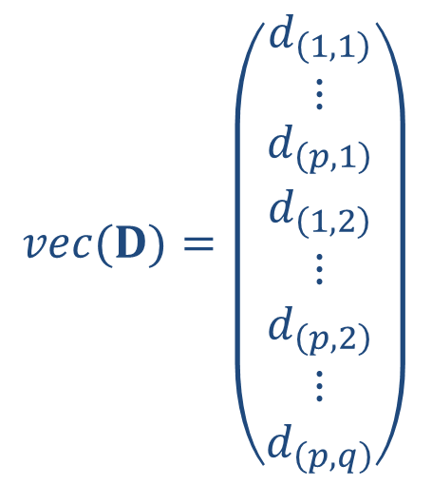
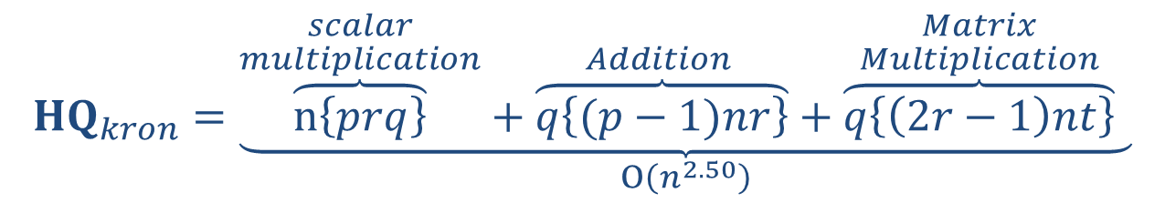
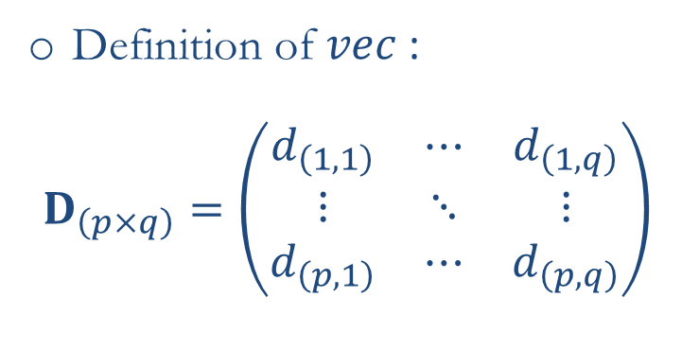

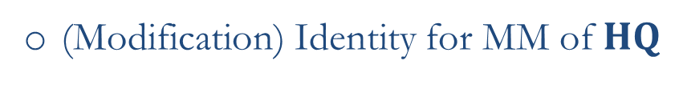
Matrix multiplication with prior covariance matrix
$$vec(D)=\left(\begin{matrix}d_{\left(1,1\right)} \\ ⋮ \\ \begin{matrix}d_{\left(p,1\right)} \\ d_{\left(1,2\right)} \\ \begin{matrix}⋮ \\ d_{\left(p,2\right)} \\ \begin{matrix}⋮ \\ d_{\left(p,q\right)}\end{matrix}\end{matrix}\end{matrix}\end{matrix}\right)$$
Definition of $vec$:
$$D_{\left(p×q\right)}=\left(\begin{matrix}d_{\left(1,1\right)} & ⋯ & d_{\left(1,q\right)} \\ ⋮ & ⋱ & ⋮ \\ d_{\left(p,1\right)} & ⋯ & d_{\left(p,q\right)}\end{matrix}\right)$$
(Modification) Identity for MM of $HQ$
$vec$[$H(D⨂E)]$ = $\left(I⨂H\right)$ $\left(vec\left(D\right)⨂E\right)$
Computational cost for matrix multiplication of $HQ$ :
$${HQ}_{kron}=\underset{O\left(n^{2.50}\right)}{\underbrace{\overset{\begin{aligned}scalar \\ multiplication\end{aligned}}{\overbrace{n\left\{prq\right\}}}+\overset{\begin{aligned}Addition \end{aligned}}{\overbrace{q\left\{(p−1)nr\right\}}}+\overset{\begin{aligned}Matrix \\ Multiplication\end{aligned}}{\overbrace{q\left\{\left(2r−1\right)nt\right\}}} }}$$

Slide 15
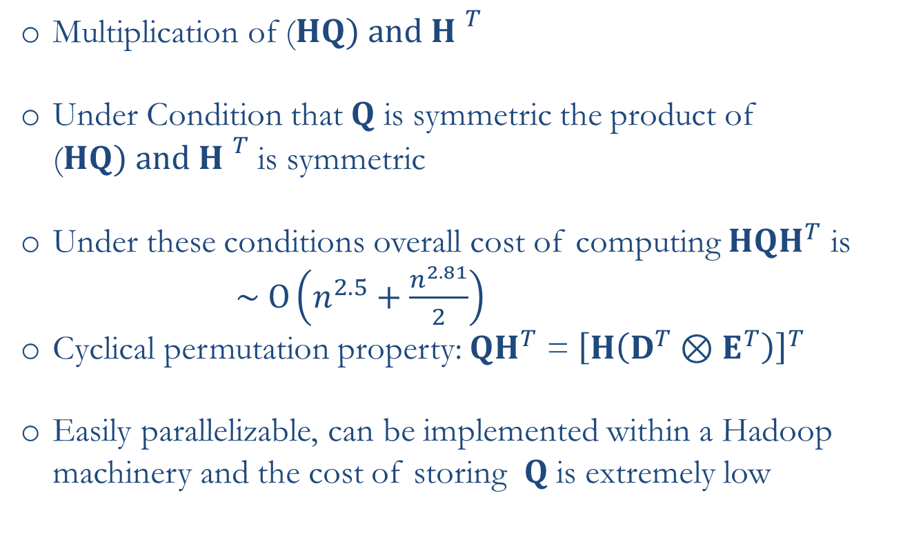
Matrix multiplication with prior covariance matrix II
Multiplication of ($HQ) and {H }^{T}$
Under Condition that $Q$ is symmetric the product of ($HQ) and {H }^{T}$ is symmetric
Under these conditions overall cost of computing ${HQH}^{T}$ is
$\sim O\left(n^{2.5}+\frac{n^{2.81}}{2}\right)$
Cyclical permutation property: ${QH}^{T}$ = ${\left[H\left(D^{T}⊗E^{T}\right)\right]}^{T}$
Easily parallelizable, can be implemented within a Hadoop machinery and the cost of storing $Q$ is extremely low

Slide 16
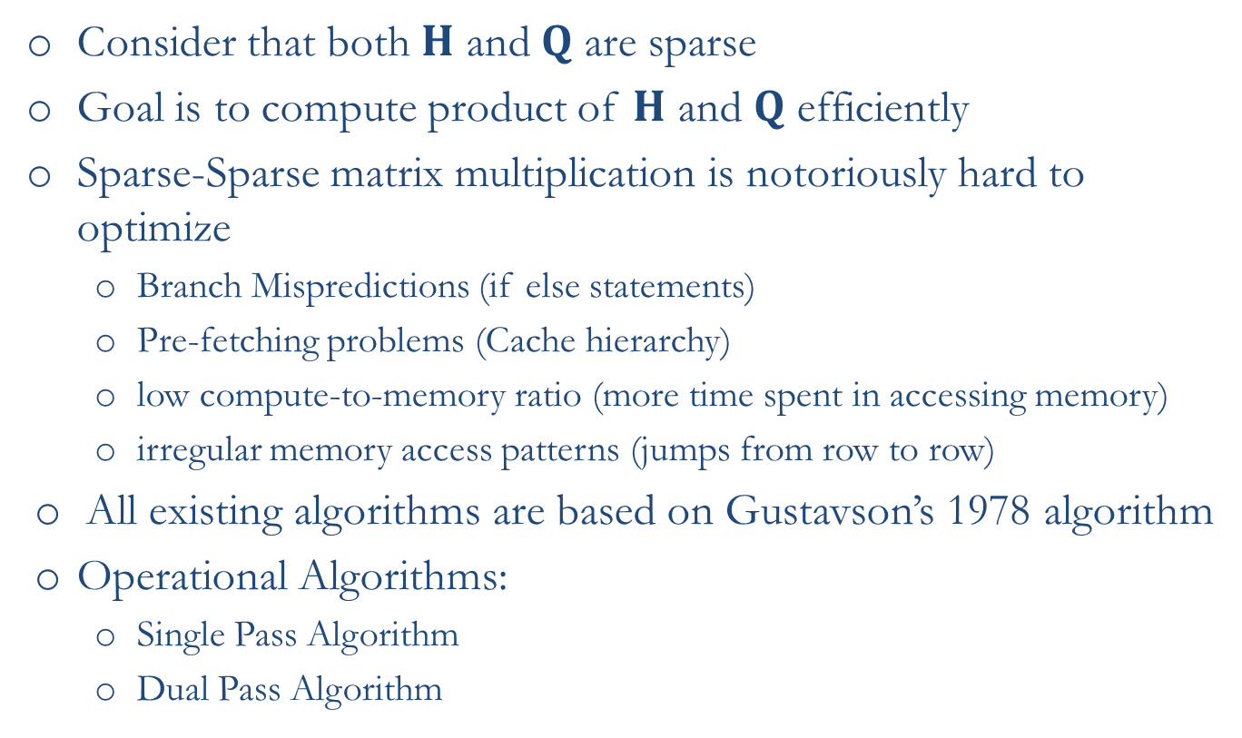
Matrix Multiplication Sparse-Sparse Case
Consider that both $H$ and $Q$ are sparse
Goal is to compute product of $H$ and $Q$ efficiently
Sparse-Sparse matrix multiplication is notoriously hard to optimize
  Branch Mispredictions (if else statements)
  Pre-fetching problems (Cache hierarchy)
  low compute-to-memory ratio (more time spent in accessing memory)
  irregular memory access patterns (jumps from row to row)
All existing algorithms are based on Gustavson’s 1978 algorithm
Operational Algorithms:
  Single Pass Algorithm
  Dual Pass Algorithm

Slide 17
Matrix Multiplication Sparse-Sparse Case II
Operational algorithms:
  Matlab ; Single Pass; Non Parallel
  Intel’s Math Kernel Library ; Double Pass; Parallel
  NVIDIA CUBLAS (GPU’s) ; Double Pass; Parallel (Count of non-zeros required)
Our Algorithm
  Single Pass Parallel when output is a non-symmetric matrix
  Single pass parallel when output is a symmetric matrix
  Can work in various hybrid parallel modes i.e., MPI, OpenMP and GPU’s
Foundation of the algorithm
  First predicts number of non-zeros in the output matrix based on vector-vector multiplication and then distributes work across machines and threads

Slide 18
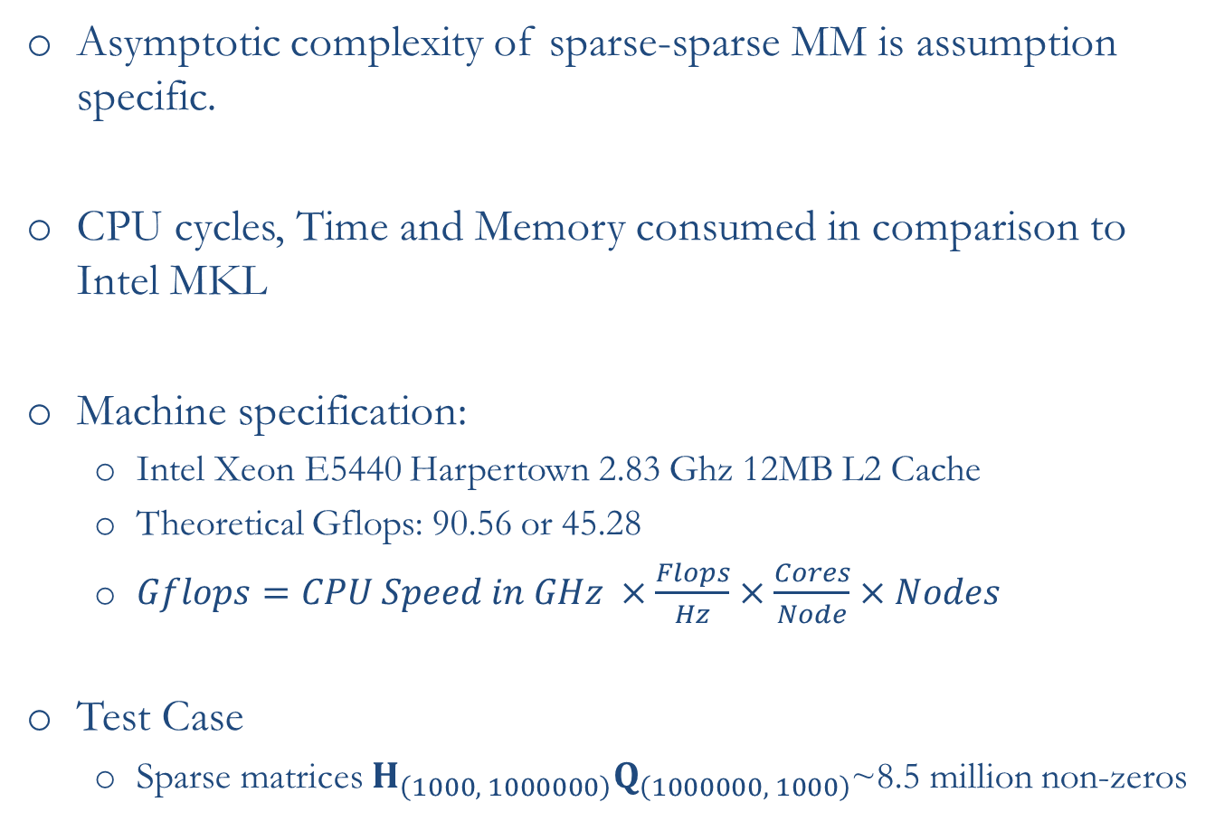
Performance of sparse-sparse matrix multiplication
Asymptotic complexity of sparse-sparse MM is assumption specific.
CPU cycles, Time and Memory consumed in comparison to Intel MKL
Machine specification:
  Intel Xeon E5440 Harpertown 2.83 Ghz 12MB L2 Cache
  Theoretical Gflops: 90.56 or 45.28
  $Gflops=CPU Speed in GHz ×\frac{Flops}{Hz}$ $×\frac{Cores}{Node}$ $×Nodes$
Test Case
  Sparse matrices $H_{\left(1000, 1000000\right)}Q_{\left(1000000, 1000\right)}$~8.5 million non-zeros

Slide 19
Benchmarks for the test machine
Linpack benchmarks
Performance of the algorithm (double precision)
 | Our Algorithm | MKL
CPU cycles | ~ 227 billion | ~ 362 billion
Time Taken for Execution | ~ 28 seconds | ~ 42 seconds
Peak Memory Consumed | ~ 2.450 Gb | ~2.576 Gb
Total Memory Consumed | ~4.885 Gb | ~3.190 Gb

Slide 20
Features of the sparse-sparse matrix multiplication algorithm
Compute upper triangular or lower triangular portion of the
output matrix
Return a dense matrix from sparse-sparse MM
Can analytically compute for non-zeros in the output matrix if
you multiply a sparse matrix with a diagonal matrix
A double pass algorithm has been implemented that has same
performance as Intel MKL
Further research:
  Building a Roofline model outlining the performance of out matrix multiplication algorithm

Slide 21
Summary and other areas of research

Slide 22
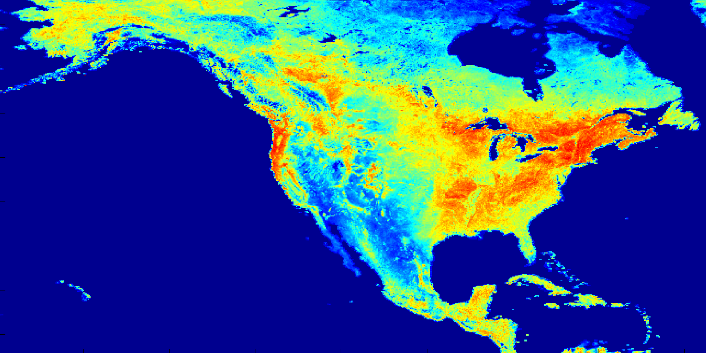
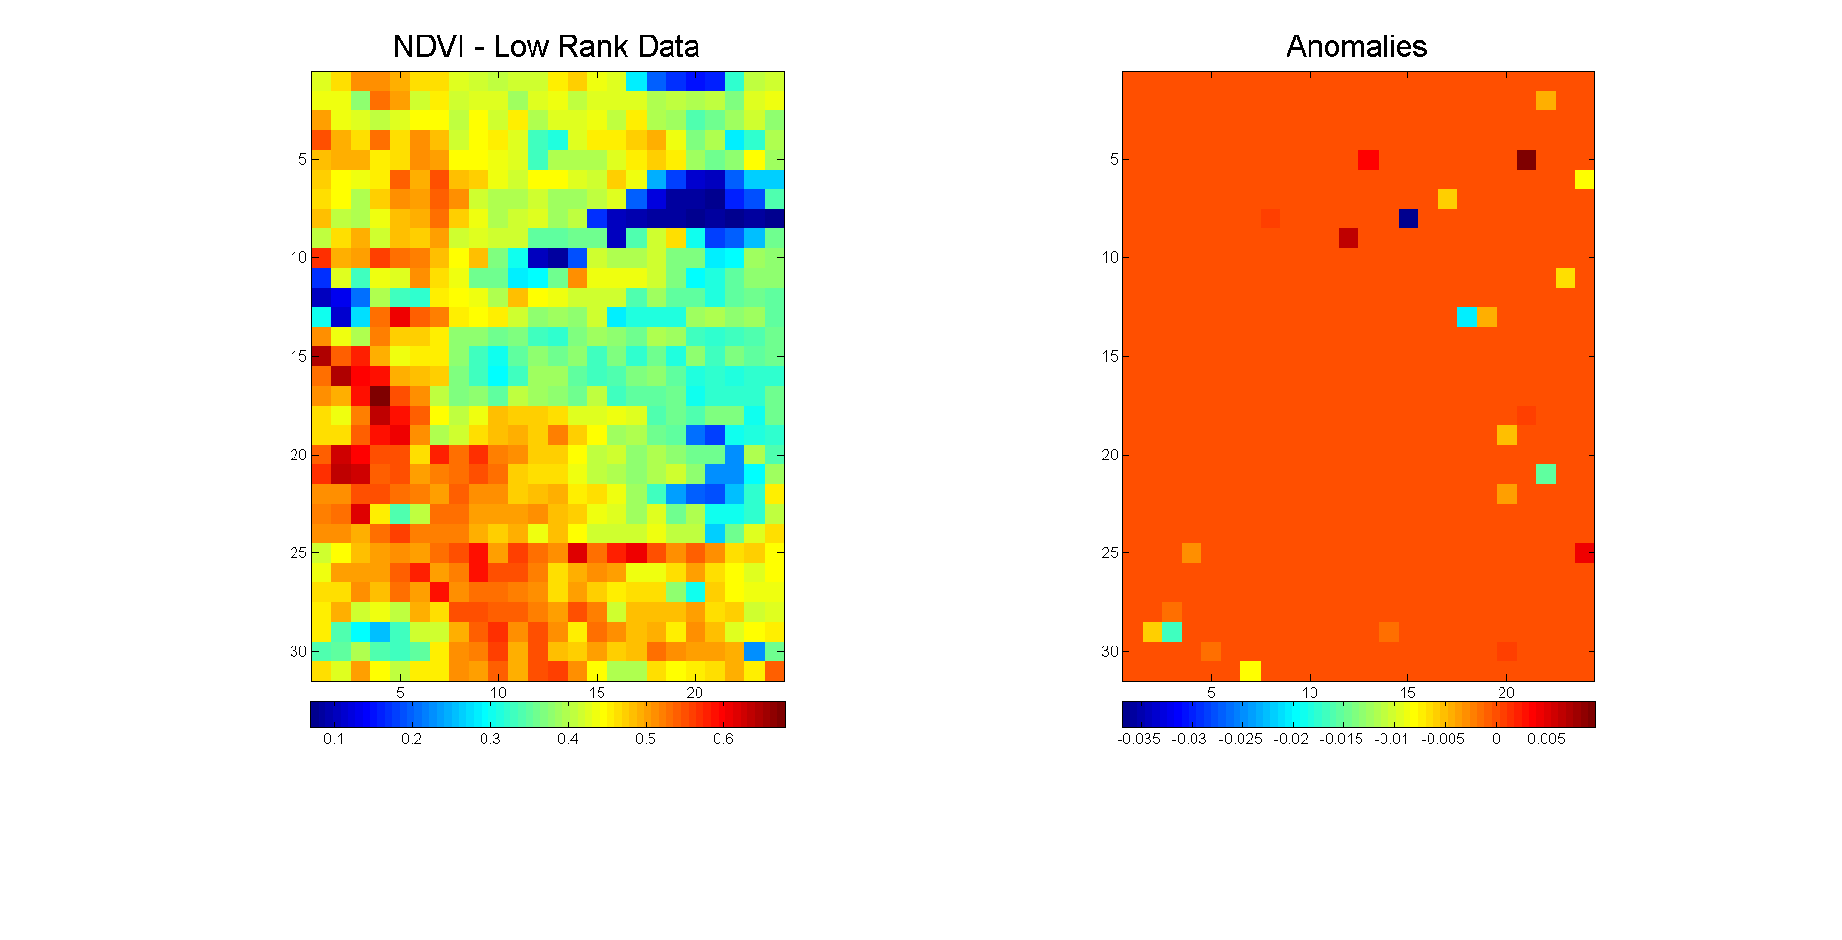
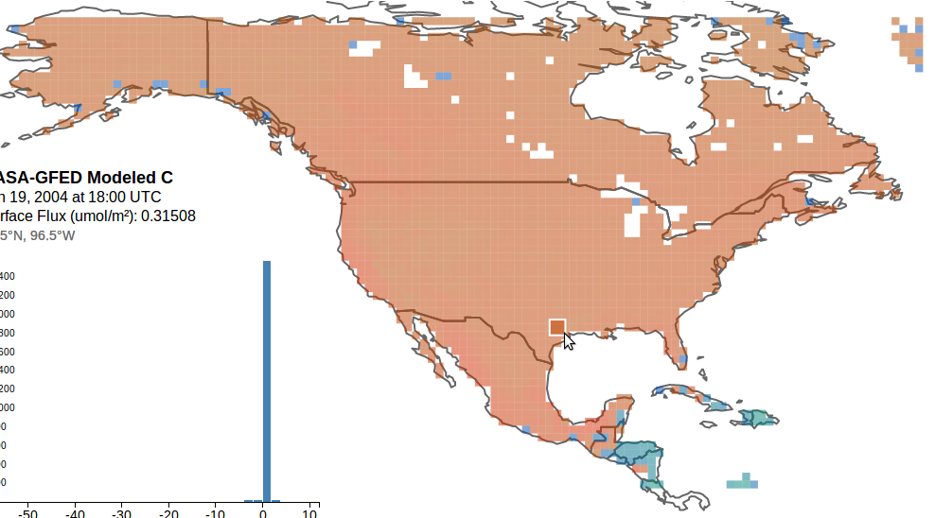
Further Research
Covariance Visualization
Anomaly Detection
Climate Change: Anomaly Detection
Covariance Visualization
 | x1, y1 | x1,y2 | x1, y3 | x1, y5 | x1,y6 | x1,y7 | x1,y8
x1, y1
x1, y2
x1, y3
x1, y4
x1, y5
x1, y6
x1,y7
Copyright 2015 California Institute of Technology. U.S. Government sponsorship acknowledged.

